Slide 1
New Era of Japan-EU
Economic Partnership
Shigehiro TANAKA
Director-General, Multilateral Trade System Department
Ministry of Economy, Trade and Industry of JAPAN
March 2014

Slide 2
Table of Contents
・Japan-EU Economic Relationship ･･･ 2
・Abenomics ･･･13
・1)Creation of New Markets ･･･17
・2) Strengthen Utilization of Human Resource ･･･23
・3) Promotion of Investment ･･･26
・4) Global Economic Integration ･･･36
1

Slide 3
Japan-EU Economic Relationship
2

Slide 4
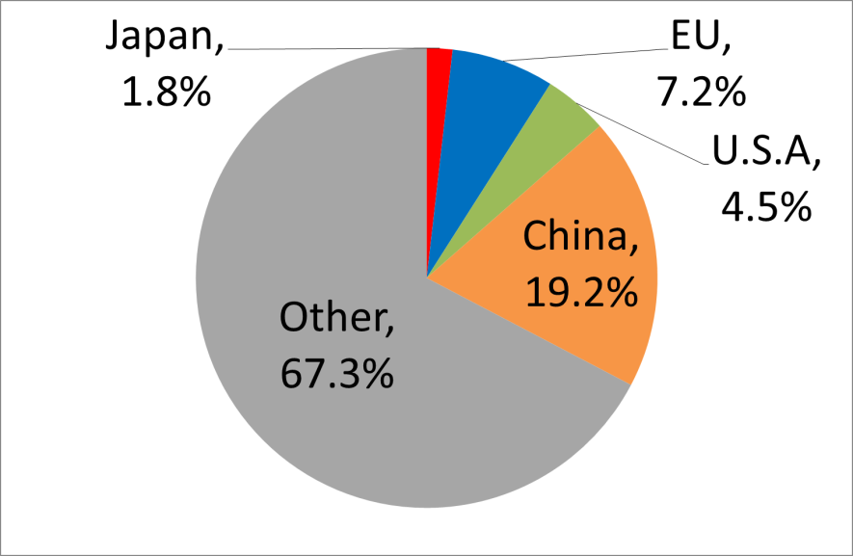
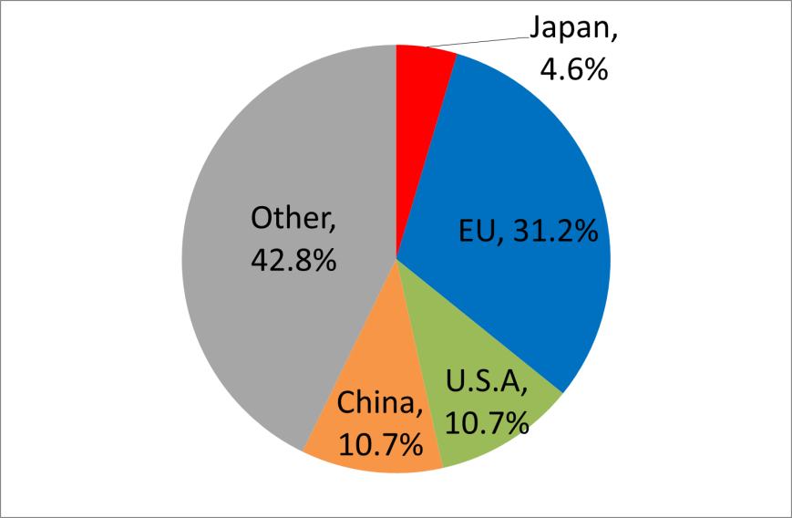
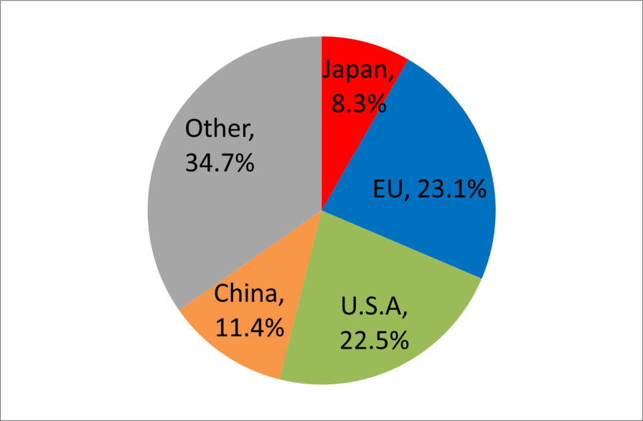
Japan-EU Position in the World
Japan and the EU combined account for approximately 10% of the world’s population, more than 30% of the world’s GDP and global trade.
Population(2012)
Japan+EU=9.0%
Trade(2012)
Japan+EU=35.8%
GDP(2012)
Japan+EU=31.4%
Source; World Bank, World Development Indicators, October 2013
Source; IMF, Direction of Trade Statistics, October 2013
Source; IMF, World Economics Outlook Database, October 2013
3

Slide 5
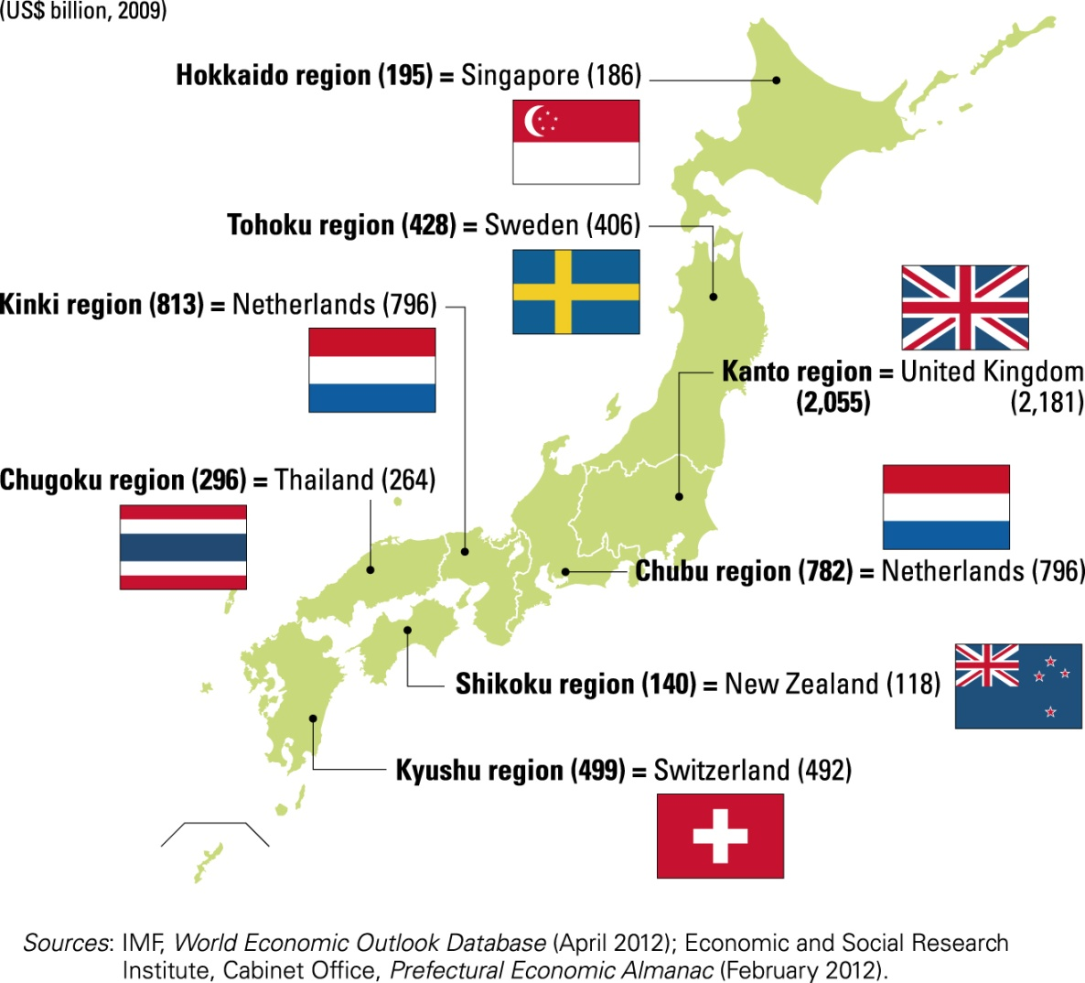

Global Consumer Market
The EU is the 2nd largest consumer market, while Japan is the 3rd. By concluding the EPA/FTA, these two markets will be integrated into the largest consumer market.
(in BN $)
1. | U.S.A | 111,496
2. | (EU) | 97,197
3. | Japan | 36,310
4. | China | 29,928
5. | Germany | 19,708
6. | U.K. | 16,268
7. | France | 15,062
8. | (ASEAN) | 12,770
9. | Italy | 12,258
10. | India | 12,253
GDP comparison of Japan’s regions with some countries
Malaysia(193)
Source: United Nation “National Accounts Main Aggregates Database” GDP
by Expenditure at current prices-US$, Household consumption expenditure
4

Slide 6
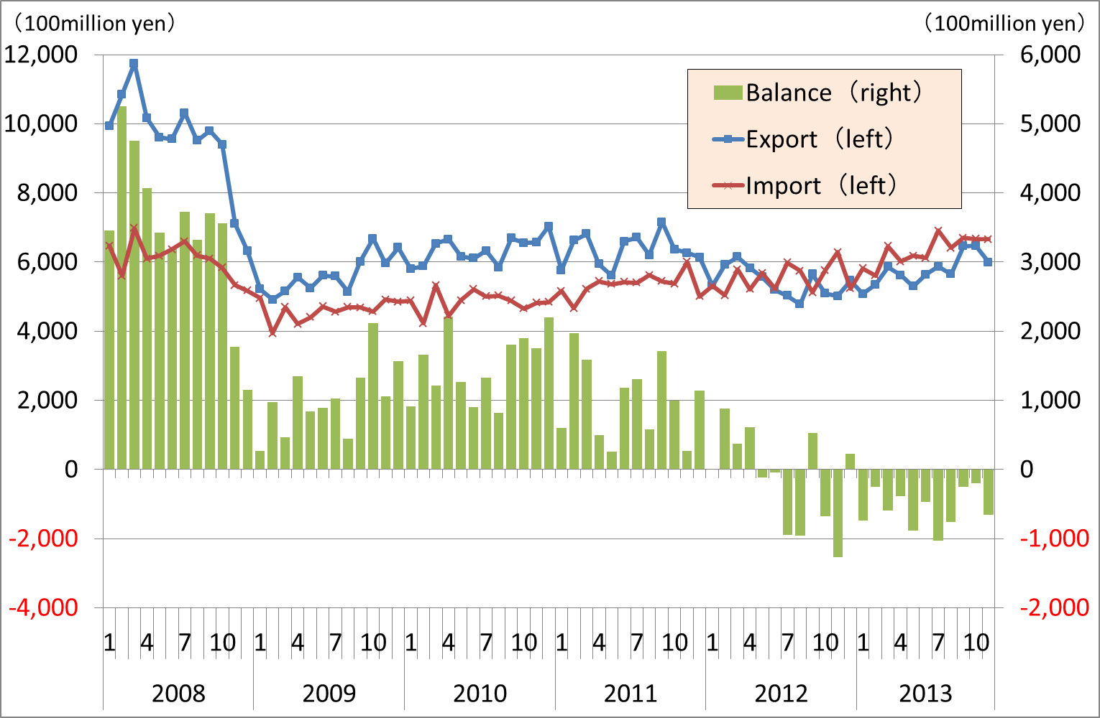
The EU marks Export Surplus to Japan
The imports from the EU increased by 3.6 % in 2012 and 15.2 % in 2013 compared to the previous year.
In 2012, the trade balance with the EU registered a deficit for the first time in 2012 since 1980, In 2013, it registered another deficit.
Japan’s trade balance with the EU
 | 2013 (Growth rate) | 2012 (Growth rate) | 2011 (Growth rate)
Export | 7,0 T yen (7.7%) | 6,5 T yen (▲14.7%) | 7.6 T yen (0.0%)
Import | 7,6 T yen (15.2%) | 6.6 T yen (3.6%) | 6.4 T yen (10.1%)
Balance | ▲0,6 T yen | ▲0,1 T yen | 1.2 T yen
Japan’s trade balance with the EU
(Preliminary figures)
Japan’s trade balance with Member States
 |  | 2013 (Growth rate) | 2012 (Growth rate) | 2011 (Growth rate)
Germany | Export | 1850 B yen (11.5%) | 1,660 B yen (▲11.3%) | 1,871 B yen (5.3%)
 | Import | 2,324 B yen (17.9%) | 1,971 B yen (6.2%) | 1,856 B yen (9.9%)
 | Balance | ▲474 B yen | ▲311 B yen | 15 B yen
France | Export | 613 B yen (14.9%) | 534 B yen (▲16.3%) | 638 B yen (9.1%)
 | Import | 1,138 B yen (11.2%) | 1,023 B yen (8.5%) | 944 B yen (4.7%)
 | Balance | ▲525 B yen | ▲489 B yen | ▲306 B yen
(Preliminary figures)
Source: Ministry of Finance Japan
Notes:
左図：日本貿易統計より作成
右図：企画調査室作成

Slide 7
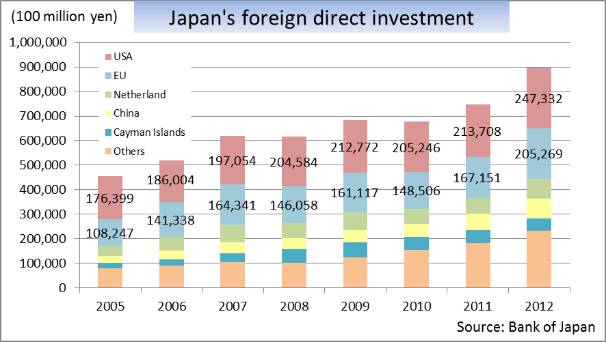
Significant Investment and Job Creation by Japanese Companies in Europe
The EU: No.1 Investor to Japan 68 billion euro(2012)
Japan: No.3 Investor to the EU 144 billion euro(2011)
Source: BOJ(calculated in arbitrated foreign exchange rate by BOJ), Eurostat
Japanese overseas affiliates in Europe
Survey of Overseas Business Activities as of 2011(FY) , METI
*Number of Employees by Japanese affiliates
UK 140,705
Germany 59,304
Netherland 58,227
Belgium 33,226
France 25,319
Italy 21,545
Spain 12,848
Number of employees: over 465,000
Number of companies: over 2,600
6
Notes:
Japanese overseas affiliates in the EU： 海外事業活動基本調査第40回（2009年度実績）反映
Number of Employees by Japanese affiliates ：海外事業活動基本調査同上
対外直接投資：日銀統計（平成22年末（直接投資残高（地域別かつ業種別）））より. http://www.boj.or.jp/statistics/br/bop/index.htm/
121009 雇用者数リバイス 大西 海外事業活動基本調査 http://www.meti.go.jp/statistics/tyo/kaigaizi/result/result_41/xls/h2c422nj.xls
http://www.meti.go.jp/statistics/tyo/kaigaizi/result/result_41/xls/h2c423nj.xls
121009 直接投資グラフ 大西 国際収支統計
http://www.boj.or.jp/statistics/br/bop/dip2011.zip
１１１０２７ 直接投資
鍵和田さんがリバイスしてくれた最新版データに更新（右上投資、左下主要国雇用）
EUの日系企業 出展：海外事業活動基本調査
１１１１１５ 販売額、域内調達額についても海外・・調査２００９年版もとに更新。
120510 EUの日系企業を更新 http://www.meti.go.jp/statistics/tyo/kaigaizi/result/result_41.html
月例経済報告の２０１０年レートを利用 １１６．４￥/Euro
売上高 251,185,352,233ユーロ
仕入高 42,909,647,766ユーロ

Slide 8

Surge of Investment to Mexico after the Japan-Mexico EPA
The Japan-Mexico EPA stimulated the new direct investment for Japan to Mexico, especially in automotive sector.
Tariff reduction on auto parts through the Japan-Mexico EPA, in effect from April 2005, encouraged an 84% increase in local production by Japanese automakers between 2004 and 2010.
Japanese automakers currently operate 6 production facilities in Mexico. Mazda and Honda recently announced the construction of new production plants in Salamanca City (starting in FY2013) and Celaya (starting in 2014), respectively.
Vehicle Production by Japanese Automakers in Mexico
(2004-2010)
Japanese Automakers’ Production Facilities in Mexico
Manufacturer | Location
Honda | El Salto
Toyota | Tijuana
Nissan | Aguascalientes
 | Civac (Cuernavaca)
Isuzu | Cuautitlan
Hino | Silao
Japan-Mexico EPA
in effect (April 2005)
Source: Marklines Database
7
Notes:
120319 ＪＡＭＡさん資料より追加
1204 タイトル付与

Slide 9
Surge of Investment with the Japan-Switzerland EPA
The Japan- Switzerland EPA increased direct investment from Japan to Switzerland.
Approximately four-fold increase from 2008, before the EPA entered into force.
(2008) (2012)
378%↑
Investment* 120 BN yen 454 BN yen
(Japan→Switzerland)
*Stock Basis
Japan-Switzerland EPA
(2009)
Source: Bank of Japan
8

Slide 10
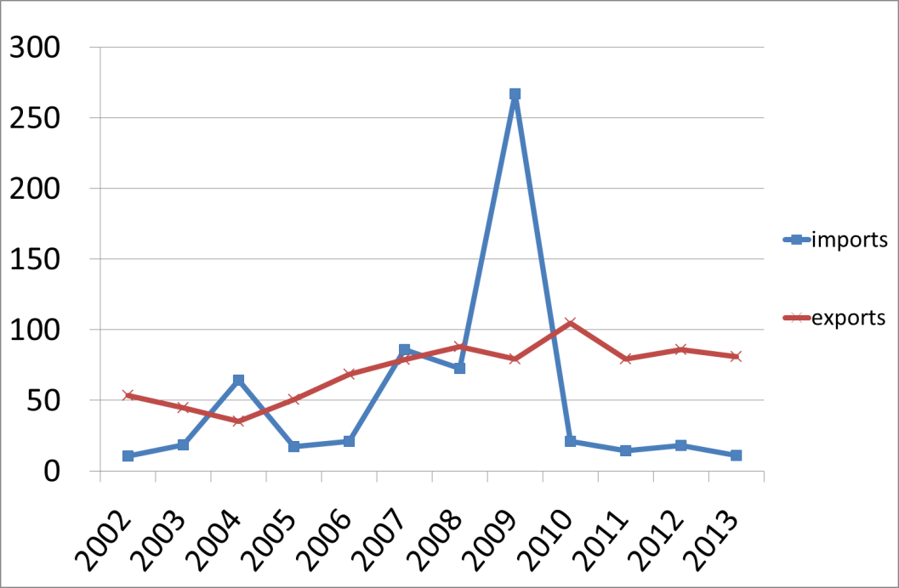
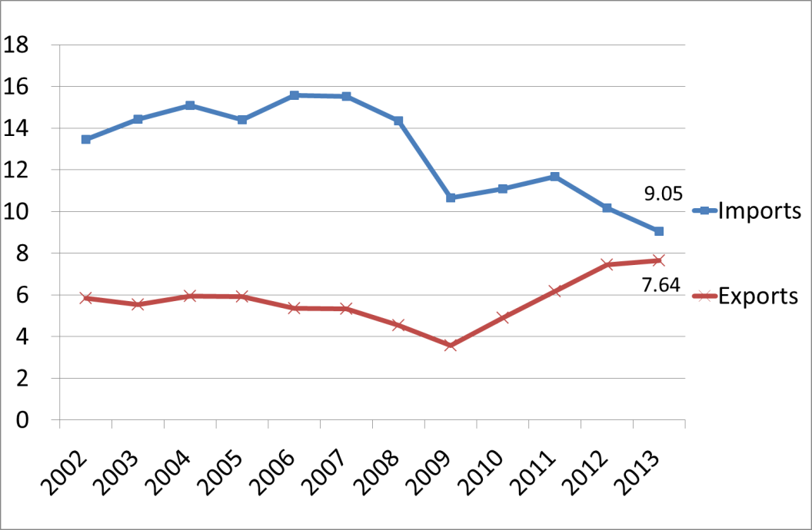
The EU Transport Equipment Trade with Japan
In railway trade, the EU has increased exports to Japan for the last decade.
In passenger cars and parts, the EU still registers a deficit with Japan, but in the last five years, the gap between import and export has decreased.
The EU Railway Trade with Japan
The EU Passenger Cars and Parts Trade with Japan
(million €)
(billion €)
Railway; 86
Source; World Trade Atlas
Passenger cars; 8703 Parts; 8708
Source; World Trade Atlas

Slide 11
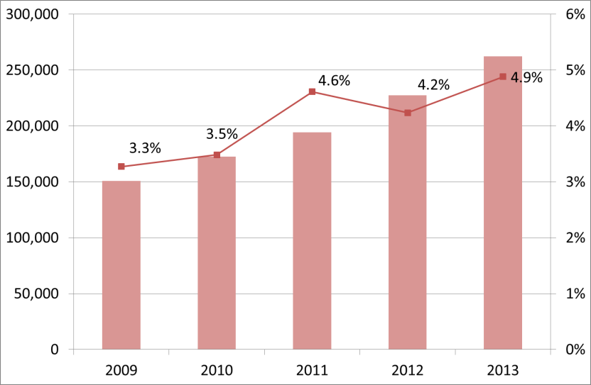
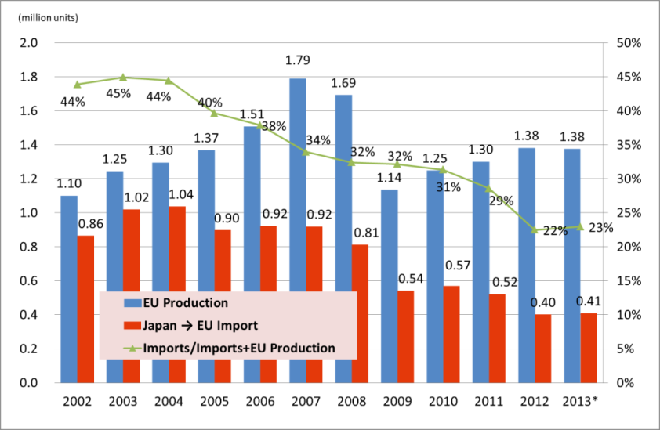
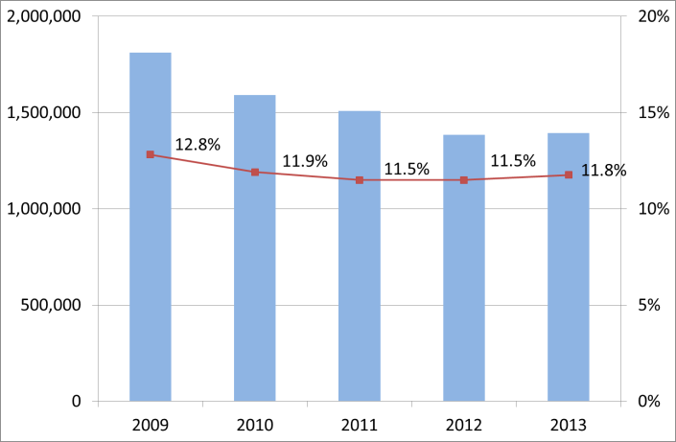
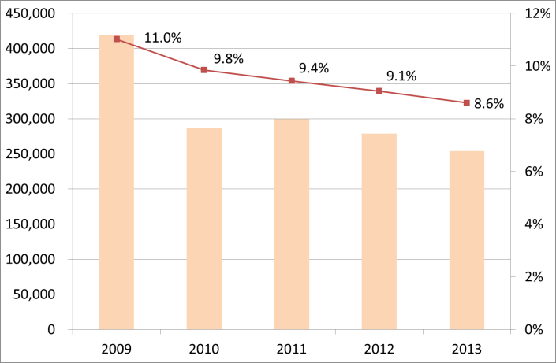
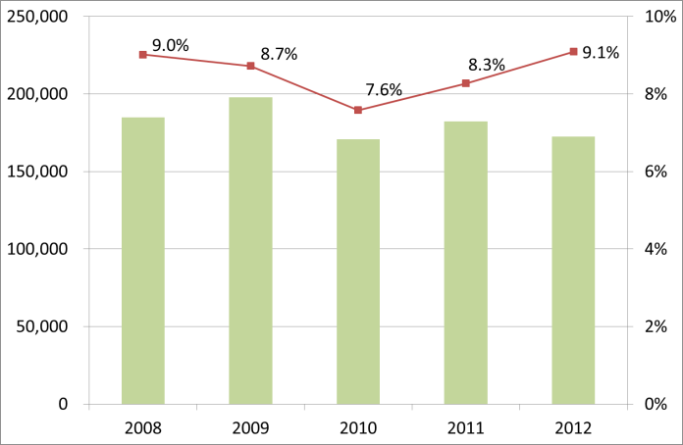
Imported Vehicles in Japan and Europe
The share of European vehicles in Japan’s domestic market has rapidly increased in the last 5 years.
The EU production by Japanese automakers increased to 1.38 million units in 2013.
More than two-thirds of Japanese vehicles sold in the EU is locally manufactured.
.
Share of European vehicles in Japan
The EU production vs. imports by Japanese automakers
(units)
Source: JADA, JAIA
Source: JAMA
*Preliminary figures
Share of Japanese vehicles in the EU
Share of Japanese vehicles in Germany
Share of Japanese vehicles in France
(units)
(units)
(units)
Source: ACEA
Source: JAMA, VDA
Source: JAMA, VDA

Slide 12
Government Procurement is Open to European Companies
European companies have increased government procurement orders and its operation in Japan
Veolia Water Japan
A Japanese corporation under a French company (environment)
Main example: Contents of the contract with Matsuyama City, Ehime Prefecture
- Contract period: Five years from 2012
- Contract value: Around 1.3 billion yen
- Order details: Entrusted management of institutions, including a water purification plant in Matsuyama City
Other examples
- Signed similar contracts with Hiroshima City, Saitama Prefecture, Chiba Prefecture, and so on (more than 19 billion yen in total since 2006)
Succeeded in signing contracts with five local governments
(more than 19 billion yen)
Siemens Japan
A Japanese corporation under a German company (industrial machinery)
Main example: An order for medical instruments from a Japanese national university hospital
- Time of order: July 2011 (Bid)
- Contract value: Around 700 million yen
- Content of Order: Radiotherapy systems
Other examples
Received orders from national university hospitals throughout the country
(More than 4 billion yen in total since 2010)
Received orders for expensive medical instruments from institutions, including national university hospitals (more than 4 billion yen)
GlaxoSmithKline (Japanese corporation)
A Japanese corporation under a British company (pharmaceuticals)
Main example: An order for medicine from the Ministry of Health, Labour and Welfare of Japan
- Time of order: March 2009 (bid)
- Contract value: Around 3.7 billion yen
- Content of Order: Anti-influenza drug
Other examples
- Received orders for Relenza from the Ministry of Foreign Affairs, Osaka Prefecture, Yamanashi Prefecture, and so on (more than 5 billion yen in total since 2009)
Received a large order for an anti-influenza drug for government stock (more than 5 billion yen)
11
11
Notes:
120413 JETROさん作成パワポ追加

Slide 13
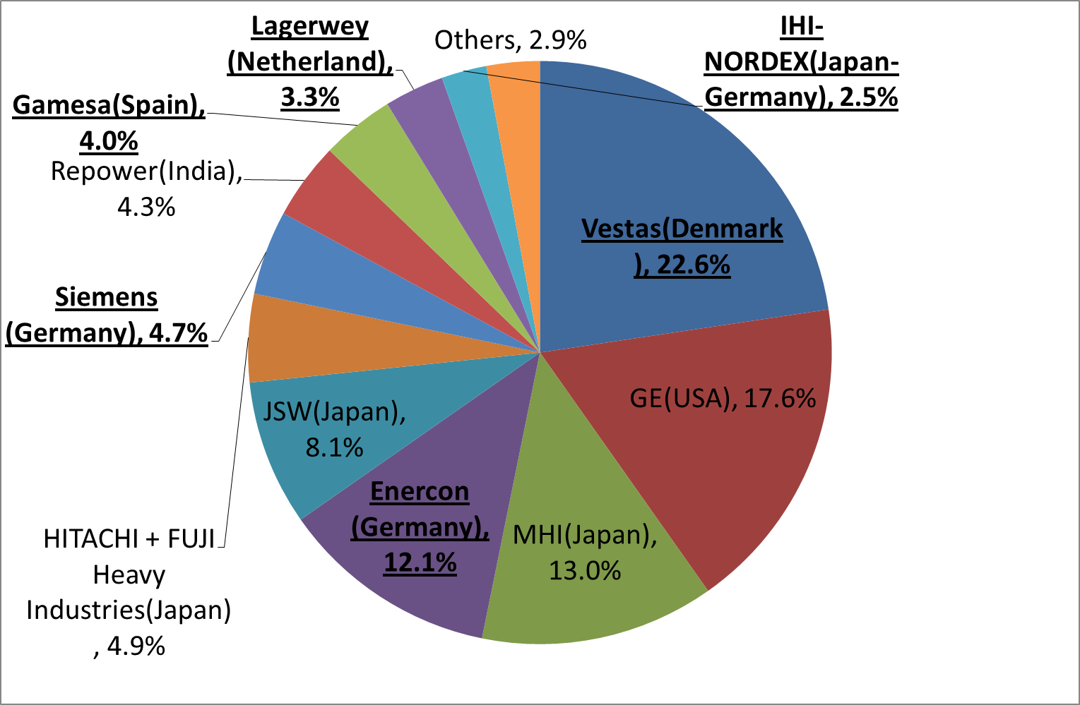
Share of Installed Wind Power Capacity in Japan – Companies (FY 2013*)
Nearly half of Japanese wind power capacity is provided by European companies.
*Preliminary figures
Source; Japan Wind Power Association
12

Slide 14
Abenomics
13

Slide 15

Three Arrows of Abenomics
The First Arrow:
Bold Monetary Policy
The Second Arrow:
Flexible Fiscal Policy
The Third Arrow:
Growth Strategy to Encourage Private Investment
14

Slide 16
Fundamental Principles of the Third Arrow ①
1) Creation of New Markets
Create new markets while also addressing common global challenges
Streamline the approval process of leading edge medical equipment, and establish an institution that comprehensively manages leading-edge research and development.
○ Major Key Performance Indicators (KPI)
Expand the market size of health care, disease prevention and other health-related industry to 10 trillion yen in 2020 (currently 4 trillion yen).
Expand the market size of pharmaceutical products, medical equipment, regenerative medicine and other medical-care-related industry to 16 trillion yen in 2020 (currently 12 trillion yen).
Expand the size of PPP/PFI projects to 12 trillion yen over the next 10 years (currently 4.1 trillion yen).
2) Strengthen Utilization of Human Resources
Increase workforce participation of women, youth and the elderly in the workforce.
Support the advancement of women's roles in the workforce and support youth in their search for employment.
Major Key Performance Indicators (KPI)
Improve female (25 to 44 years of age) participation in the workforce from the current rate of 68% to 73% by 2020.
Reduce by 20% the number of long-term unemployed (more than 6 months) over the next five years and increase the rate of employment change and new hiring from 7.4% in 2011 to 9%.
Double the number of international students by 2020 (university students and other students from 60,000 to 120,000).
15

Slide 17
Fundamental Principles of the Third Arrow ②
3) Promotion of Investment
Corporate investment is to be encouraged to maximize the potential of the private sector.
Bold regulatory and institutional reform, bold tax incentives for capital investment.
Major Key Performance Indicators (KPI)
Return capital investment to the pre-global-financial-crisis level within three years (target: 70 trillion per year; FY2012: 63 trillion yen).
Enhance the ratio of business startups to exceed the ratio of business closures and bring those ratios to a level comparable to the U.S. and UK, which is above 10% (current rate in Japan is approximately 5%).
4) Global Economic Integration
Promote integration with the global economy through encouraging overseas expansion of Japanese companies and foreign direct investment.
Promote economic cooperation such as TPP and the Japan-EU EPA, create the most business friendly environment through regulatory reform driven by the establishment of the National Strategic Special Zones, and enhance foreign direct investment.
○ Major Key Performance Indicators (KPI)
Increase the trade conducted under FTAs to 70% by 2018 (currently 19%).
Double the amount of direct investment in Japan by foreign companies to 35 trillion yen by 2020.
Attract 10 million international tourists annually in 2013 and 30 million in 2030.
16

Slide 18
1) Creation of New Markets
17

Slide 19
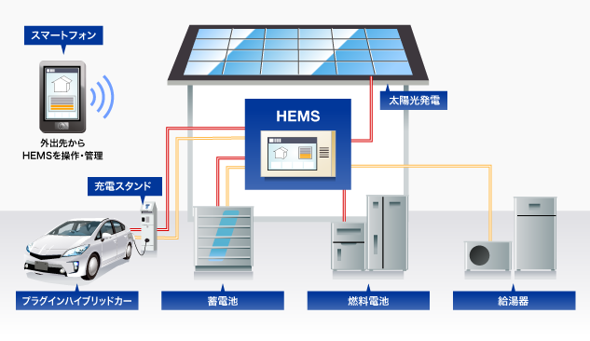
Creating New Businesses and Reforming in the Electric Power Systems
Japanese government enhances new business in the energy market through implementing the reform of the Electricity Power System.
Energy Control Using an Energy Management System
Implementing Reforms of the Electricity System
1st stage (by approx. 2015)
  ◆ Establishment of the Organization for Cross-regional Coordination of Transmission Operators (OCCTO).
  →nation-wide grid system
2nd stage (by around 2016 )
◆ Full liberalization of the retail market.
3rd stage (by around 2018 - 2020)
◆ Unbundling of transmission and distribution sector.
◆ Full liberalization of retail rates.
Smartphones
Enacted the related bill
Solar Cells
Management and operation from outside of the house
Plug-in Station
The related bill was submitted
to the current Diet session
Plug-in Hybrid Car
Rechargeable Batteries
Fuel Cells
Water Heater
Home Energy Management System (HEMS) by Denso Corporation
18

Slide 20
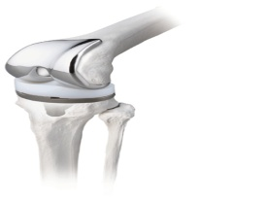
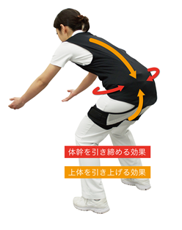
Creation of New Industries in Response to Japan’s Aging Society
- Examples from the Healthcare Sector
Pharmaceutical Affairs Law was revised last autumn
（As part of the regulatory reform in the field of healthcare）
Major revisions in the related bills
of the Pharmaceutical Affairs Law, etc.
Medical Device Making Use of SME Manufacturing Technology
Speed up the certification for innovative medical devices.
Example.
Tailor-made Joint Prostheses
・Apply its propeller manufacturing technique for tankers.
・Develop decreased-wear and more durable joint prostheses suited for Japanese body type and lifestyle.
Review times for medical devices behind the US
(Priority Review Products)
Months
Nakashima Medical Co., Ltd,
(Okayama pref. Capital: 50 million yen Employees: 153)
Productivity Improvement in Nursing Care Business
[Example] SMART SUPPORT Corporation
(Use of nursing care robots contributes
to improving the productivity
of nursing service.)
Source: Pharmaceuticals and Medical Devices Agency (PMDA)
(2) Faster authorization in Regenerative Medicine.
Reduce the burden on nurses
Establish an early authorization system.
19

Slide 21
Sector-Specific Regulatory Reform
～Medical Devices and Pharmaceutical～
Medical Devices
●Authorization procedures ● Quality Management System : QMS
● Labelling requirements ● Stand-alone medical software
Revision of the Pharmaceutical Affairs Law was enacted in the extraordinary Diet session in Autumn 2013.
Details will be stipulated by lower level legislation (ministerial orders, etc.)
Pharmaceutical
Vaccines
In order to ensure consistency with international standards in terms of specifications and testing methods for vaccines, “Minimum Requirements for Biological Products” was revised on September 2013.
Good Clinical Practice : GCP
To ensure consistency of the GCP Ordinance with the content of ICH-GCP Guidelines, GCP Ordinance was amended in December 2012.
Expansion of Japan-EU MRA (Good Manufacturing Practice :GMP)
Japan is now proceeding with application for membership in Pharmaceutical Inspection Co-operation Scheme (PIC/S).
20

Slide 22
Sector-Specific Regulatory Reform ～Automotive～
Adoption of UNECE regulations
Automotive Safety Devices
-Pyrotechnic Safety devices-
METI expanded the scope of exemptions for the Explosive Control Act concerning automotive pyrotechnic safety devices in February 2012.
-Hydrogen Gas Airbags-
(the generic exemption of airbags containing hydrogen gas from import inspection)
METI has decided to finalize examination by March 2014 and amend the relevant regulations afterwards, by the end of 2014.
  MLIT (Ministry of Land, Infrastructure, Transport and Tourism) published roadmap on 29 March, 2013.
35/47 passenger vehicle regulations adopted
8 regulations are in the process of adaptation
additional work is also in progress
Zoning for automobile service shops
On addressing the Technical Guideline from 2011, the number of approvals in FY2012 is more than double (32) that of FY 2011 (14).
High-pressure gas tanks
The gtr (Phase 1) was adopted in June 2013 at UNECE/WP29. Japan will adopt the gtr by the end of June 2014.
21

Slide 23
Sector-Specific Regulatory Reform ～Food Safety～
Food additives
Beef Import
The ban on imports of cattle meat and offal was lifted.
France (Feb 2013)
cattle aged 30 months or under
Netherlands (Feb 2013)
  cattle aged 12 months or under
Ireland (Dec 2013)
  cattle aged 30 months or under
With the following 7 food additives newly designated since the Cabinet Decision in July 2012, 37 out of 45 common, internationally used food additives have been designated to date.
Magnesium hydrogen phosphate
Calcium saccharin
Potassium lactate
Potassium sulfate
Calcium acetate
Calcium oxide
Isopropanol
The remaining 8 additives and Sunflower lecithin are in the process of designation
Organic food
(labelling, documentation requirements, etc.)
A comprehensive package agreed on by MAFF and DG-AGRI was implemented on 1 April, 2013.
The Ministerial Ordinance was amended on 1 April, 2013.
22

Slide 24
2) Strengthen Utilization of Human Resources
23

Slide 25
Attract Human Resources from Overseas
Review the points-based preferential immigration system for foreign professionals
Increase the number of people accepted through this system
(about 430 since the program was introduced in 2012)
Regarding university reform, increase the number of foreign researchers
Offer 1,500 full-time positions for overseas researchers over the next 3 years
Review of the immigration process for highly-skilled foreign professionals
Relax annual income criteria
(e.g. reviewing the definition of annual income to include rewards from overseas institutions)
Reduce the time that foreign nationals are required to reside in Japan before being eligible for permanent resident status (from 5 years to 3 years)
The related bill to be submitted to the current Diet session
24

Slide 26

Enhancing Flexibility of Labor Market
A drastic shift in employment policy in supporting labor mobility to support new industries
Enhancing skills for career changes
Current: Mainly support people in maintaining current jobs in companies.
Shift policies to supporting training programs to upgrade skills for career changes.
Strengthening job matching
Current: Information owned by ”Hello Work” (governmental unemployment office) is not shared with private sector.
i) Disclosing information to private sector on job offers/ job seeking held by public sector.
ii) Enhancing matching function by utilizing private-sector human resources.
Current
Low labor mobility
After reform
Support for maintaining jobs
Support training programs
for career changes
Old Industries
New Industries
Old Industries
New Industries
“Hello Work”
“Hello Work”
Private HR business
Sharing information
Private HR business
<FY 2012>
Majority of labor budget is allocated to training programs to let the people maintain their jobs. (3 digits larger than training programs for career changes) (\113.4 billion allocated to maintain jobs; \240 million for career changes)
More budgets for training programs for career changes than those to maintaining jobs.
<FY 2014 Proposal>
\54.5 billion to maintain jobs, \ 30 billion for career changes.
<FY 2015>
Reverse budgetary balance between two types of programs.
Other issues related to labor policy
Reviewing rules on working hours, diversified ways of working.
Establishment of a committee composed of government, labor and management to discuss the distribution of the fruits of growth and structural reforms in the labor market.

Slide 27
3) Promotion of Investment
26

Slide 28
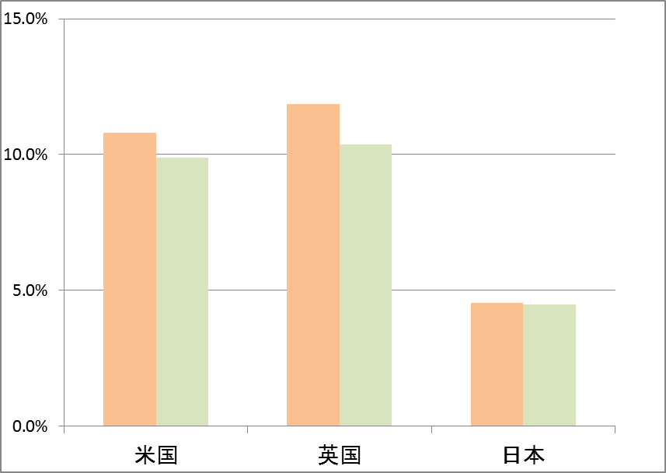
Promotion of Business Restructuring
Promotion of investment for venture/start-up business
Level of business startup and termination rates has stayed lower in Japan, less than half that of US and UK.
Counteract shrinking risk-money flow to venture companies after Lehman crisis.
To promote venture/start up investment,
Accept 80% of investment amount for venture funds as deductible expense.
Business startup and termination rates
Trends of money flow to venture companies
11.9%
Startup rate
Fell dramatically after Lehman crisis
10.8%
10.4%
Termination rate
9.9%
Foreign investors, Other domestic investors
4.5%
4.5%
Bank, Securities, Insurance
Corporation
US
UK
Japan
（Billion）
Private investors
US： U.S. Small Business Administration “The Small Business Economy:A report to the President(2011)”
UK： Office for National Statistics “Business Demography(2010)”
Japan： Ministry of internal affairs and communications
※ US： Average of year 2004 to 2008 ※ UK, Japan： Average of year 2004 to 2009
…
Source: METI based on researches of Venture Enterprise Centre
Enhanced corporate governance
Revision of corporate law to require at least one outside director.
“Comply or Explain Rule”
If a company will not comply with the rule, the company must explain why the company cannot have an outside director.

Slide 29
Subsidy Program for Projects Promoting Asian Site Location in Japan
The central government and local governments offer a variety of subsidies, and both central and local government subsidies may be receivable for the same project.
Subsidized Projects | Eligible Costs | Subsidy Rates/ Maximum Amount
Establishment of R&D facilities or Regional Headquarters in Japan by Global Companies | Survey Design Costs, Facility Costs, Equipment Costs, Facility Rental Fees | Up to 1/2 for SMEs; Up to 1/3 for non-SMEs; Up to 2/3 for disaster afflicted areas;

Slide 30
Subsidy Program for Projects Promoting Asian Site Location in Japan
Companies Selected for the Subsidy Programs
＜FY 2010 Subsidy Program＞
* alphabetical order
№ | Company name | Global HQ | Sector
1 | Eurocopter Japan T&E Co., Ltd. | France | Special-purpose helicopters
＜FY 2011 Subsidy Program＞
№ | Company name | Global HQ | Sector
1 | DSM Japan Engineering Plastics K.K. | Netherlands | Chemicals (Plastic)
2 | Intelligent Energy Holdings Plc | U.K. | Fuel cells
3 | Medasys Japan K.K. | France | Medical information system
4 | Mikado Kyowa Seed Co., Ltd. (Subsidiary of Vilmorin & Cie S.A.) | France | Vegetable seeds
5 | Sanofi-Aventis K.K. | France | Pharmaceuticals
6 | Umicore N.V. | Belgium | Industrial chemicals (Catalyst)
7 | Volvo Technology AB | Sweden | Technology development related to automobiles
＜FY 2012 Subsidy Program＞
№ | Company name | Global HQ | Sector
1 | Faurecia Japan K.K. | France | Automotive component（Automotive seating）
＜FY 2013 Subsidy Program＞
№ | Company name | Global HQ | Sector
1 | BASF Japan, Ltd. | Germany | Chemistry (battery materials)
2 | Nippon Busch K.K. | Germany | Vacuum pumps and systems
3 | Siemens Japan K.K. | Germany | Fields related to Positron Emission Tomography (PET) drug products

Slide 31


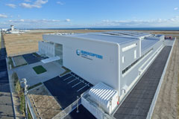
Subsidy Program for Projects Promoting Asian Site Location in Japan
Companies selected for the Subsidy Programs
Apr. 09, 2013
Eurocopter Japan Co., Ltd., establishes
an R&D center in Kobe
Jul. 18, 2013
Subsidiary of major French pharmaceutical company Sanofi establishes regional headquarters in Tokyo
Eurocopter Japan Co.,
Ltd., the Japanese subsidiary of European helicopter manufacturer, Eurocopter, established an R&D center in Kobe. It is the first foreign aviation manufacturer to establish an R&D center in Japan. The center is located in the aircraft maintenance facilities and training center in Kobe Airport, has a key role in developing optional equipment for
special-mission
helicopters, designing
onboard installation
and installing
equipment.
The company had designated
Japan, Korea, Australia and
New Zealand as its JPAC
(Japan & Pacific) Region,
an area of advanced markets
for medical and pharmaceutical products, establishing its regional office in Tokyo to comprehensively manage the region’s financing, human resources, strategies, and regulatory affairs. By positioning supervisory functions for its JPAC Region in Japan, it is expected that the Japanese subsidiary will grow in importance in the region and become a focal point for global resources.
30

Slide 32
Preferential Treatment by the Act (*)
For R&D facilities and Regional Headquarters
Corporate tax breaks
(from approximately 36% to 29% )
Acceleration of visa issuing procedures
(ordinarily 1 month → around 10 days)
Acceleration of patent examinations
(ordinarily: around 16 months
→ around 2 months)
(*) Act for Promotion of Japan as an Asian Business Center
31

Slide 33






“Invest Japan Hotline”
JETRO supports foreign companies by
Providing consultation regarding administrative procedures required for FDI into Japan.
Arranging meetings with officials of regulatory agencies if needed.
Relaying requests for regulatory reforms to the Japanese government.
- Questions on administrative procedures
- Requests on regulatory reforms
“Invest Japan Hotline”
(JETRO)
The Cabinet Office will request that the competent authorities consider possibilities for reform.
Certain answers from the competent authorities may be reported to the Regulatory Reform Council for discussion.
The results of deliberations at the Council will be reported to the company through JETRO if it is to be released to the public.
Requests for regulatory reforms
JETRO will submit requests for regulatory reforms to the Cabinet Office and METI
JETRO will:
answer questions directly
ask questions to the relevant authorities on behalf of the company.
Company
JETRO
Questions
Requests
JETRO will arrange meetings with officials of regulatory agencies.
Complicated questions on administrative procedures
JETRO will support to applications for some government subsidies and translate their documents into French, English and German.
Assistance to be given on an individual basis in collaboration with relevant government authorities.
Questions
Answers
Meeting
Official in charge
32
Copyright (C) 2013 JETRO. All rights reserved.

Slide 34

Optimized for Innovation
Japan provides an ideal environment for R&D.
  R&D expenditures per GDP and the number of researchers per capita is No.1 among G8 countries.
  Japanese firms rank high in global patent applications.
  Japan has produced many Nobel Prize laureates. 15 Japanese scientists received the Nobel prize.
Gross domestic expenditure on R&D as a percentage of GDP (2009)
Share of PCT applications by country of origin (2011)
Note: PCT: Patent Cooperation Treaty
Source：WIPO
Japanese Nobel Prize Laureates since 2008
Year | Name | Category
2012 | Shinya Yamanaka | Physiology or Medicine
2010 | Ei-ichi Negishi | Chemistry
2010 | Akira Suzuki | Chemistry
2008 | Makoto Kobayashi | Physics
2008 | Toshihide Maskawa | Physics
2008 | Osamu Shimomura | Chemistry
Source: OECD, “Main Science and Technology Indicators: Volume 2012/1”
Source: Nobel Prize.Org
Notes:
<Page 3/14>
まず第１の強みは、日本がイノベーションに最適な国であり、研究開発拠点として理想的な環境を提供していることです。いくつか具体例をご紹介しましょう。
①まず、世界経済フォーラムが公表している「国際競争力ランキング」によると、日本のイノベーション能力は世界第１位となっています。
②次に、左側のグラフをご覧ください。主要国における研究開発費の対ＧＤＰ比を比較したものです。日本の研究開発費の割合は３．４％で、G８諸国の中で最も高くなっています。
③また、右上の円グラフをご覧ください。特許協力条約（ＰＣＴ）の国際出願件数の国別割合を示しています。日本の割合は２１％で、世界第2位の国際出願大国となっています。
④さらに、右下の表をご覧ください。日本はノーベル賞を受賞した研究者を多数輩出しており、２００８年からの５年間で６人が受賞しています。２０１２年には、京都大学の山中伸弥教授が、ｉＰＳ細胞の研究でノーベル生理学・医学賞を受賞しました。この点は、皆様の記憶に新しいことと思います。
以上のように、日本は研究開発拠点の立地先として、理想的な国であると言えます。

Slide 35
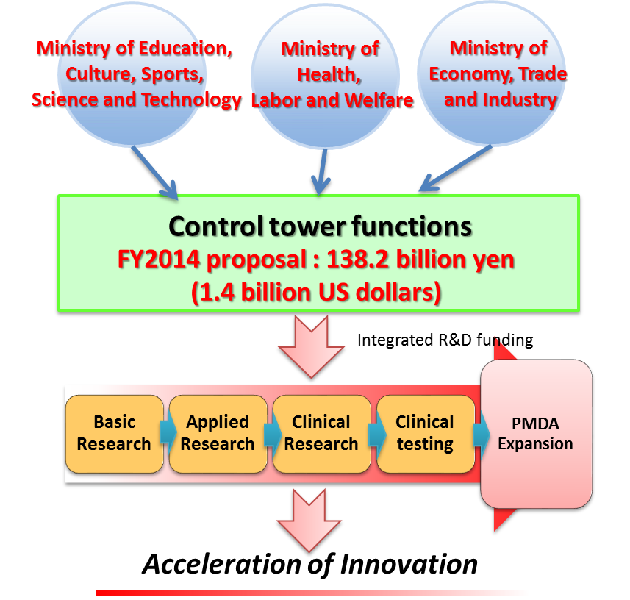
All Japan Innovation Strategy
Reinforcing headquarter functions of the “Council for Science and Technology Policy”
  The related bill to be submitted to the current Diet session
Establishing control tower functions in medical R&D
The related bill to be submitted to the current Diet session
Cross-ministerial Strategic Innovation Promotion Program (SIP)
A cross-ministerial program that facilitates cooperation across across ministerial boundaries and industrial sectors.
The Council for Science and Technology Policy identifies challenges and allocates budgets accordingly.
Impulsing PAradigm Change through disruptive Technologies (ImPACT)
Drives high risk, high impact research and development that will bring huge paradigm change to Japan's industry, economy and society.
1US$=about 100YEN
34

Slide 36
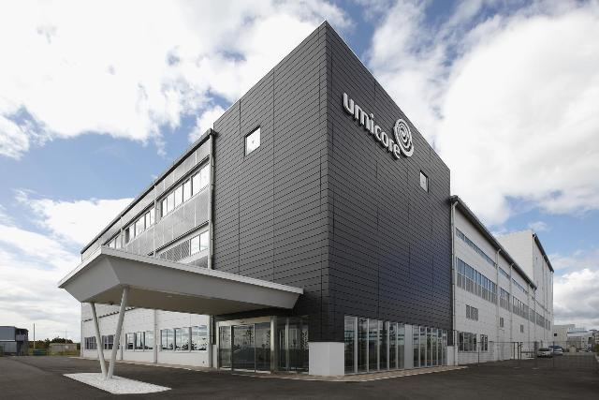
EU-Japan Investment in Innovation
Apr. 07, 2010
Umicore Japan KK to invest JPY4 billion to produce lithium ion battery materials in Kobe
Umicore’s JPY 4 billion investment in Kobe-city will provide a vital production presence in Japan and will employ 40 people once it reaches its designed capacity. The investment will also incorporate a new technical center for the testing and validation of materials for customers. This center will mostly employ university graduates and will expand according to customer requirements.
Source; http://www.umicore.jp/ja/umsjInfo/ujpPressRelease/show_20100407_umicore_investment_in_Kobe_EN.pdf
Jan. 24, 2013
BMW Group and Toyota Motor Corporation Deepen Collaboration by Signing Binding Agreements
Munich. BMW Group and Toyota Motor Corporation (TMC) are pursuing their successful strategic long-term cooperation in the field of sustainable mobility today by signing binding agreements aimed at long-term collaboration between the two companies for the joint development of a fuel cell system, joint development of architecture and components for a sports vehicle, and joint research and development of lightweight technologies. These agreements follow a memorandum of understanding signed in June 2012.
Source; http://www.bmwgroup.com/e/0_0_www_bmwgroup_com/investor_relations/corporate_news/news/2013/Vertragsunterz_Toyota_Jan_13.html
35

Slide 37
4) Global Economic Integration
36

Slide 38
Development of Japan’s EPA/FTA Networks
In force/Signed ( 12 countries and 1 region )
Asia | Singapore | Asia | Viet Nam
 | Malaysia |  | India
 | Thailand | Latin America | Mexico
 | Indonesia |  | Chile
 | Brunei |  | Peru
 | ASEAN | Europe | Switzerland
 | Philippines
In force/Signed
Under Negotiation
Launched negotiations
Japan-EU・EPA
China-Japan-Korea FTA
TPP
( Trans-Pacific Partnership )
Under Negotiation ( 5 countries and 5 regions )
Asia | Mongolia | Pacific | Australia
 | C-J-K | Europe | EU
 | RCEP | North America | Canada
 | Republic of Korea (Negotiations suspended ) | Latin America | Colombia
Asia/ Pacific | TPP | Middle East | GCC*
RCEP
( Regional Comprehensive Economic Partnership )
( ASEAN, Japan, China, Korea, India, NZ and Aus. )
Launched negotiations ( 1 country )
Middle East | Turkey
* GCC: Gulf Cooperation Council (UAE, Bahrain, Kuwait, Oman, Qatar, Saudi Arabia)
37

Slide 39
Supply Chain in East Asia
Many intermediary goods are traded within East Asia. They are assembled in East Asia and exported to huge markets including East Asia itself as well as the EU and NAFTA.
East Asia
（2010）
Korea
The size of the arrow reflect the trade amount (billion dollars)
70.4
42.5
1,971.5
151.2
45.5
46.6
193.8
38.2
63.4
China
100.9
ASEAN
208.6
26.7
104.9
142.6
208.4
Japan
94.1
80.8
The share of intermediary goods
197.2
145.3
84.2
80.5
70%～
60%～
50%～
40%～
30%～
～30%
65.0
140.5
54.4
93.9
65.8
119.5
372.9
428.5
115.9
EU
NAFTA
2,791.7
278.5
380.8
839.1
Source : RIETI-TID 2011
38
●多くの中間財（部品）が日本、韓国及びＡＳＥＡＮから中国に輸出され、中国で組み立てられた
完成品が北米・ＥＵ等の大市場国に輸出されている。
●東アジアにわたって構築されたサプライチェーンをカバーする経済連携の実現が重要。

Slide 40



Japan-EU EPA/FTA
Japan and the EU combined account for approximately 10% of the world’s population, more than 30% of the world’s GDP and global trade.
Both are highly sophisticated economies and societies. The integration of these markets will contribute to global economic development.
At the same time, both can lead the rule-making globally along with TPP(Trans-Pacific Partnership) and TTIP (Trans-Atlantic Trade and Investment Partnership).
ＴＴＩＰ
Ｊａｐａｎ-ＥＵ・
ＥＰＡ
ＴＰＰ
39
39

Slide 41
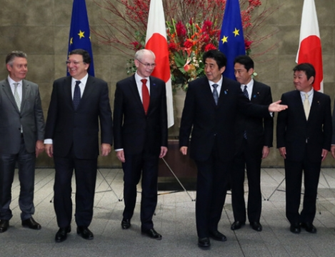
Japan-EU EPA/FTA
In March 2013, the launch of the negotiation in the conference call between the EU and Japan leaders. Since April 2013, four rounds of negotiation meetings have taken place.
Leaders on both sides committed to an early conclusion of the agreement.
Japan’s interest
EU’s interest
1）Elimination of high tariffs on industrial products( e.g. automobiles: 10%, electronic devices: 14%) will improve competitive condition for Japanese products in the European market.
2) Regulatory issues facing Japanese companies in Europe should also be proactively addressed in the negotiations.
Non-Tariff Measures(NTMs) on automobiles, chemicals, electronic devices, food safety, processed food, medical devices, and pharmaceuticals, among others.
Government procurement(e.g. railways).
Elimination of tariffs on the main export products to Japan.
21st Japan-EU Summit Joint Press Statement -19 Nov, 2013
Para3：Summit leaders underlined the importance of continued progress in the ongoing negotiations for a Strategic Partnership Agreement (SPA) on a comprehensive basis and an ambitious Economic Partnership Agreement (EPA) / Free Trade Agreement (FTA) since the start of the negotiations in April. With a shared perception of the great importance of these two agreements as long-standing foundations for their future partnership, Summit leaders reiterated their commitment to the earliest possible conclusion of these two agreements and instructed the Ministers/Commissioners to press forward the negotiations further. They will, therefore, present without delay ambitious market access offers on trade in goods, trade in services and
Para39：Summit leaders recognized the important contribution of the Japan-EU Business Round Table (BRT) to the development of bilateral economic relationships, and reaffirmed their determination to continue cooperation with the business communities on both sides, notably through the BRT, in order to strengthen relations further.
40

Slide 42






























Supporters for the earliest conclusion of the Japan-EU EPA/FTA
1. EU-Japan Business Round Table
2. BUSINESSEUROPE
3. KEIDANREN
3. EUROCHAMBERS
4. European Business Council In Japan(EBC)
5. European Chemical Industry Council (CEFIC)
6. European Ceramic Industry Association (Cerame-Unie)
7. Confederation of National Association of Tanners and Dressers of the European Community (COTANCE)
8. Digital Europe (DE)
9. European Federation of Pharmaceutical Industries and Associations (EFPIA)
10. European Cultural and Creative Industries Alliance (ECCIA)
11. European Apparel and Textile Confederation (EURATEX)
12. Retail, Wholesale and International Trade Representation to the EU (EuroCommerce)
13. European Association of Metals (Eurometaux)
14. European Services Forum (ESF)
15. Federation of the European Sporting Goods Industry (FESI)
16. FoodDrinkEurope
17. Foreign Trade Association (FTA)
18. International Federation of the Phonographic Industry (IFPI)
19. European Confederation of the Footwear Industry (CEC)
20. European Committee of Domestic Equipment Manufacturers (CECED)
21. European Furniture Industries Confederation (EFIC)
23. European Semiconductor Industry Association (ESIA)
24. LIGHTINHG EUROPE
26. Japan Chemical Industry Association(JCIA)
28. Japan Textile Federation (JTF)
30. COPA-COGECA
31. European Liaison Committee for Agricultural and Agri-Food Trade (CELCAA)
32. Japan Electronics and Information Technology Industries Association (JEITA)
33. Japan Business Council in Europe (JBCE)
41

Slide 43
Thank you.

