Slide 1
COVID-19 Crisis: Asian Populism and its Discontents
Richard J. Heydarian

Slide 3
Structure and Agency interaction: Three S’s
State Capacity
Social Cohesion
Stewardship

Slide 5
“All the world’s a stage…and one man in his time plays many parts.” Shakespeare

Slide 6
Populism and Popularity
The atavistic need for a tough leader, a “father figure,” which explains why Mr. Duterte’s populist peers are experiencing historic approval ratings. At the height of the crisis, India’s Narendra Modi saw his approval ratings surging to 90 percent, while Turkish President Recep Tayyip Erdogan enjoyed a 14-point bump.
Even Brazil’s Jair Bolsonaro, widely seen as among the most incompetent leaders in recent months, is garnering his best approval ratings yet.
But, above them all, at 91 percent, is Mr. Duterte

Slide 9
Simulacra Politics: Art of Impression Management
Ability “project” leadership in our postmodern simulacrum where “impression management” trumps actual performance.
Scholars often use the term “performative governance” for this brand of leadership. The great scholar of populism Ernesto Laclau also aptly used the term “empty signifier.”
In the midst of this crisis, we have seen an emotionally transparent leader, ringed by generals and top Cabinet members, delivering regular state-of-the-nation perorations pass midnight.
Reference Bias shift: Meanwhile, legions of online propagandists carefully nip any criticism in the bud and tirelessly reinforce a curated image of a decisive and reliable leader.
Asymmetric Culpability: Blame anyone but the top leader ("Heaven is high and the emperor is far away".)
Info-overload and Disinformation: In our attention-deficit “age of social media,” do people really care about detailed, factual analyses?

Slide 10
Strongman Syndrome

Slide 16
The Naked Emperor: Right-Wing Populism

Slide 17
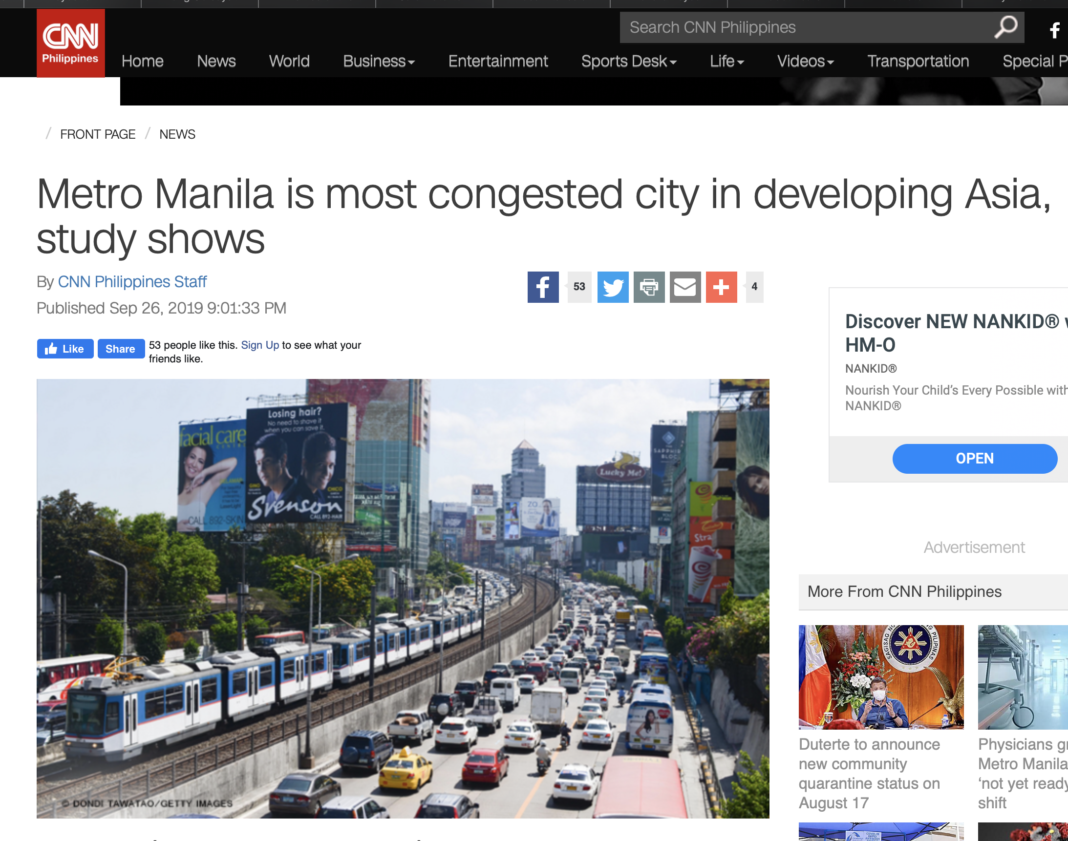
In Context….

Slide 24
Not only the longest lockdown (longer than even Wuhan!)

Slide 25
Early warning….

Slide 27
Politicization of Public Health amid reduced Budget

Slide 28
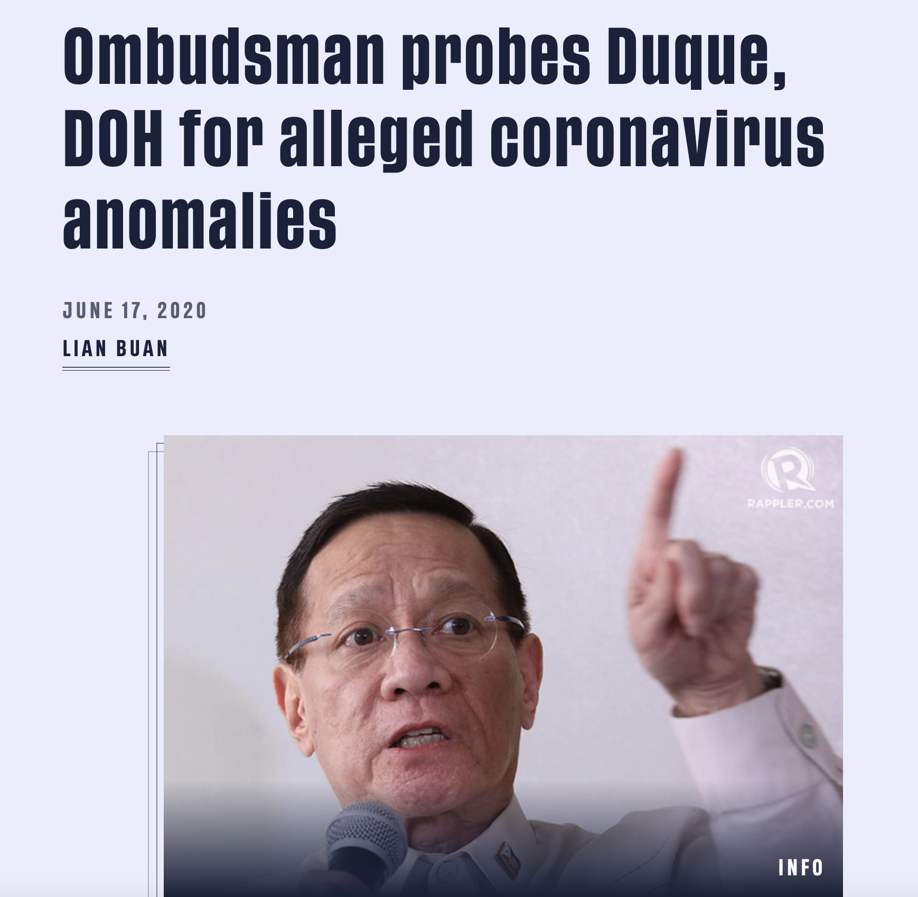
Corruption Scandals in Most Crucial Agencies

Slide 31
Contract Tracing and Mass Testing Backlogs

Slide 32
Mis-priorities

Slide 33
No Economic Recovery Program, Despite Major “Borrow, Borrow, Borrow”

Slide 34
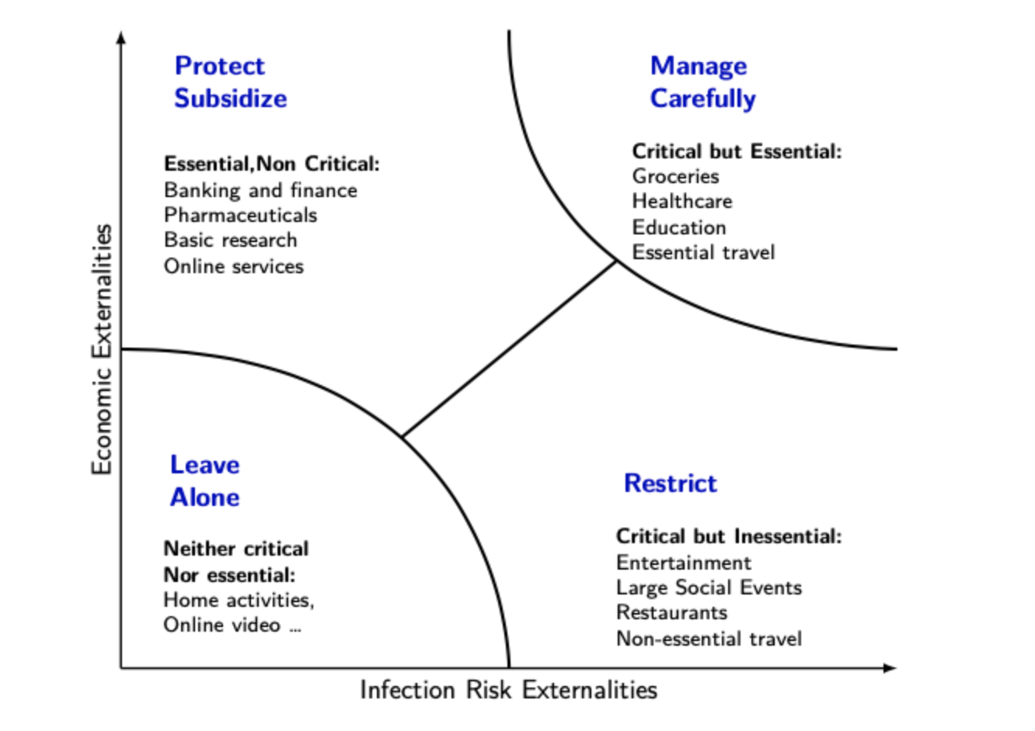
Vaccine Or nothing: No “Dance” after “Hammer”

Slide 35
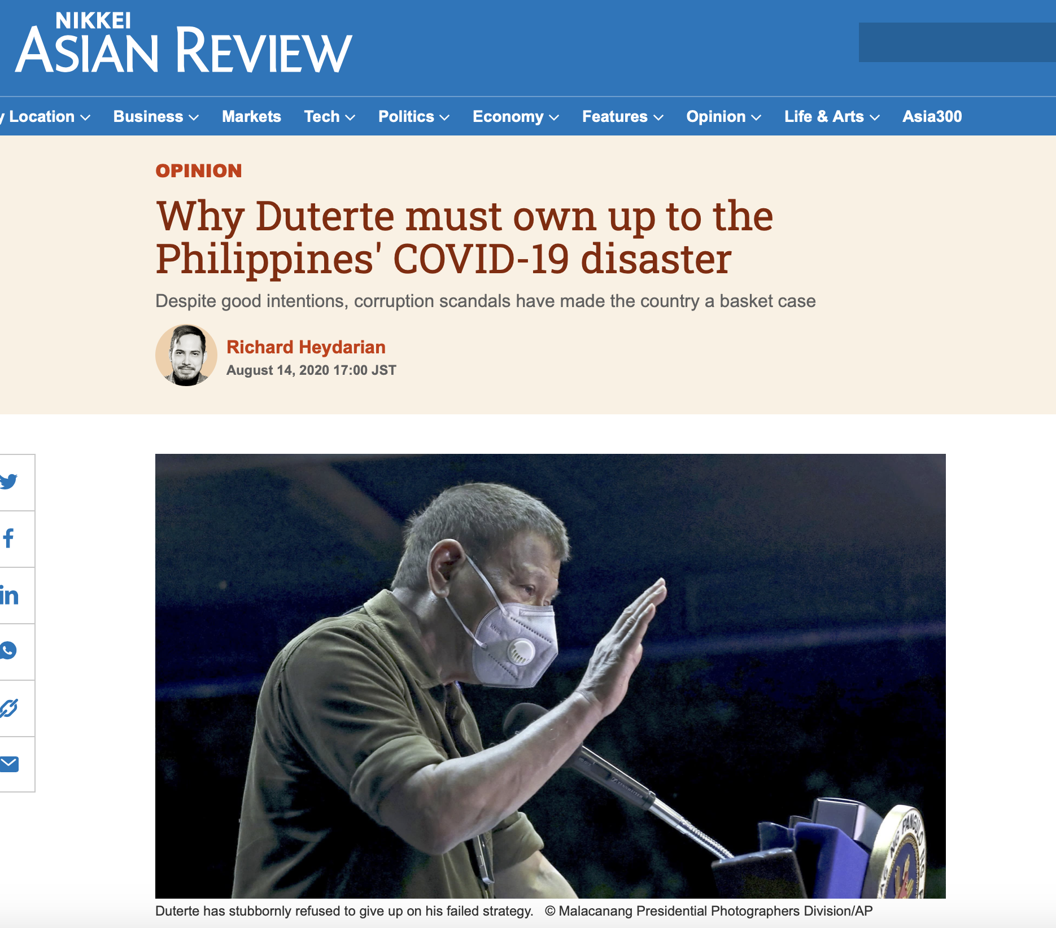
What and How Did it Go So Wrong

Slide 36
Satisfaction Surveys in climate of Fear

Slide 37
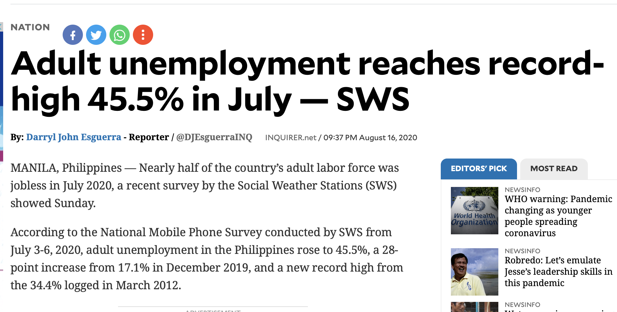

Slide 38
Blame Game

Slide 40
Post-Populism? The Yorme, the Billionaire, and the Pacman

